Slide 1

MAE 640 Rocket Propulsion II Lecture 01A Course Introduction
Description of Syllabus Material
Review of Fundamental Concepts from Chapters 1, 2 and 3
Discussion of Thrust Equation
Dr. Robert A. Frederick, Jr.
Professor, UAH MAE Department
Director, UAH Propulsion Research Center
Robert.Frederick@uah.edu
Phone: 256-503-4909

Slide 2
Lecture 01A – Course Introduction

Slide 3
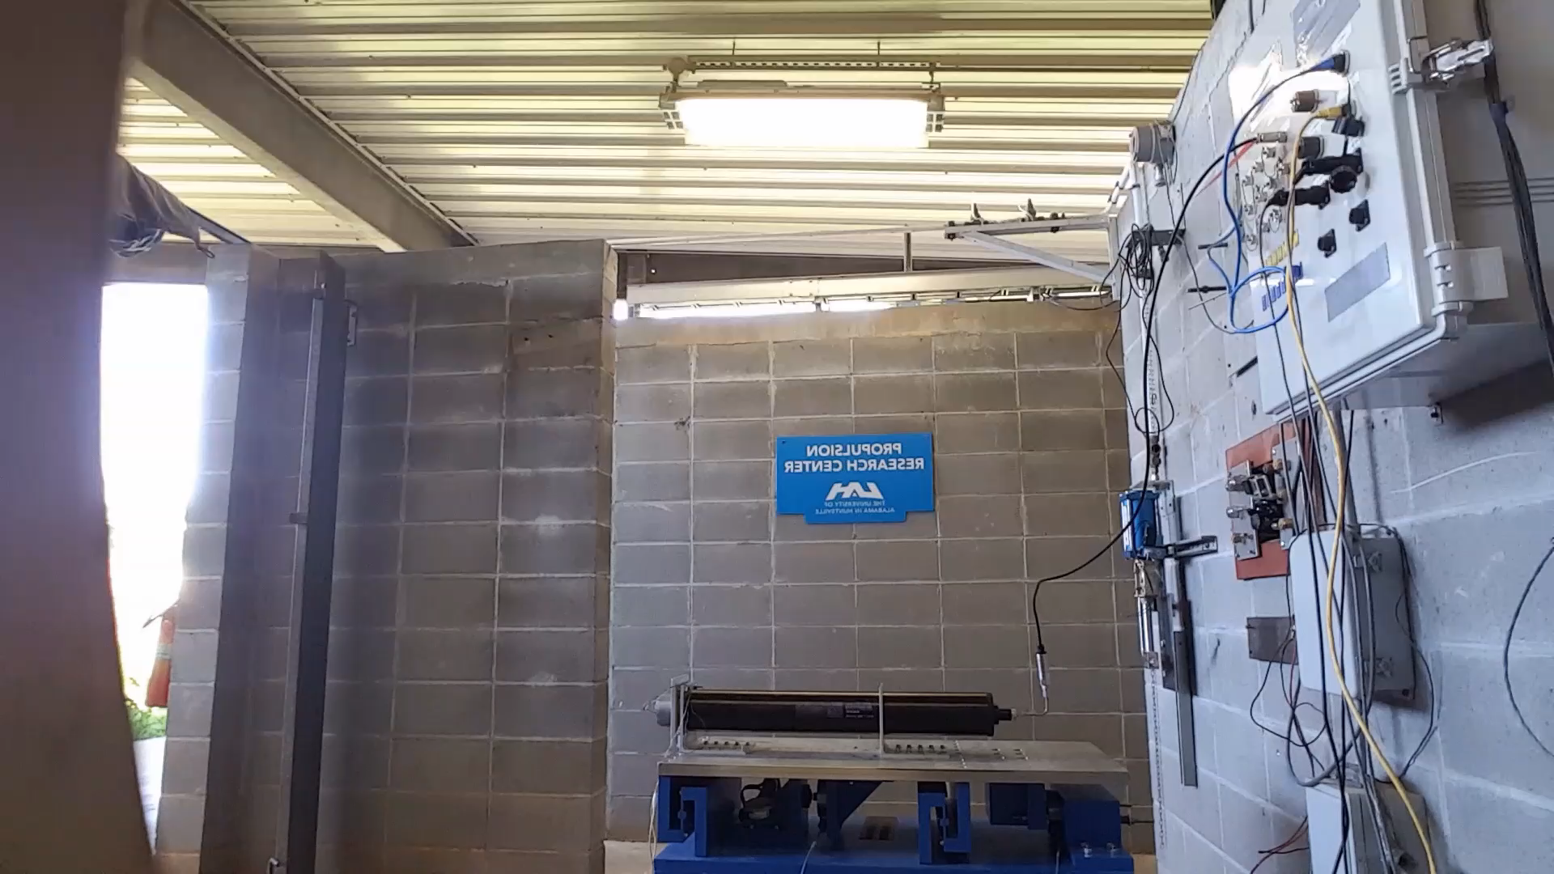
UAH Propulsion Research Center

Slide 4
Course Objectives
Course Description
Aerothermodynamics of rocket propulsion systems; rocket propellants and combustion; heat transfer and cooling problems. Application to ramjets and hybrid systems. Prerequisite: MAE 540 or permission of instructor.
Course Objectives
Students will be able to define key rocket propulsion terms.
Students will be able to calculate component and systems performance using rocket propulsion principles.
Students will be able to use thermochemcial codes, design equations, and relevant technical literature to design a rocket combustor or propulsion system to meet specific design objectives.

Slide 5
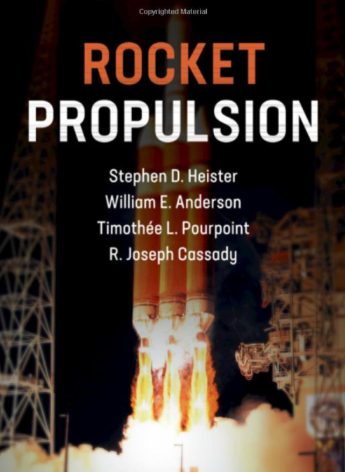
Required Text/Readings
Required Text/Readings
This book was selected because it gives students up to date and practical engineering material on rocket propulsion in a manner consistent with college-level instruction. The book can be purchased as a hardback or an online version.
Heister, S. D., Anderson, W.E., Pourpoint, T. L., and Cassady, R.J. Rocket Propulsion, Cambridge Aerospace Series, 2019, Hardback, ISBN: 9781108422277
Heister, S. D., Anderson, W.E., Pourpoint, T. L., and Cassady, R.J. Rocket Propulsion, Cambridge Aerospace Series, 2019, Online, ISBN: 9781108422277, FORMAT: Adobe eBook Reader, ISBN: 9781108397100

Slide 6
Chapters Covered from the Book
Chapter 1 - Classification of Prop. Sys. & Historical Perspectives
Chapter 2 - Mission Analysis Fundamentals
Chapter 3 - Trajectory Analysis and Rocket Design
Chapter 4 - Rocket Nozzle Performance
Chapter 5 - Combustion and Thermochemistry
Chapter 6 - Heat Transfer in Chemical Rockets
Chapter 7 – Solid Rocket Motors
Chapter 8 - Liquid Rocket Engines
Chapter 9 - Liquid Rocket Propellants
Chapter 10 - Rocket Turbomachinery Fundamentals
Chapter 11 - Hybrid Rocket Engines
Chapter 12 - Combustion Instability

Slide 7
Approach
Module 1 - Fundamental Concepts (Book Chapter 1, 2,3 and 4)
Module 2 - Hybrid Rocket Engines (Book Chapter 11)
Module 3 - Combustion and Thermochemistry (Book Chapter 5)
Module 4 - Heat Transfer in Chemical Rockets (Book Chapter 6)
Module 5 - Liquid Rocket Engines (Book Chapter 8)
Module 6 - Liquid Rocket Propellants (Book Chapter 9)
Module 7 - - Turbomachinery and Combustion Instability (Book Chapters 10 and 12)
Module 8 - Class Project (Material Provided)

Slide 8
Module Learning Objectives - Example
Module 01 – Fundamental Concepts
Students will be able to demonstrate basic knowledge of propulsion terminology and the results of the last class project
Students will be able to calculate the performance of an over-expanded nozzle that has separated flow
Students will be able to derive the thrust and exit velocity equations for a converging-diverging nozzle from the conservation of momentum and conservation of energy equations.

Slide 9
Module Components - Example
Module 01 - Fundamental Concepts
Module Checklist
☐ Attend (and or view) Lectures 1A and 1B
☐ Review Course Syllabus
☐ Review textbook chapter 1, 2, 3 and 4
☐ Complete Quiz 1
☐ Attend or Review Office Hours/Help Session ☐ Complete Homework 01 (01HW)

Slide 10
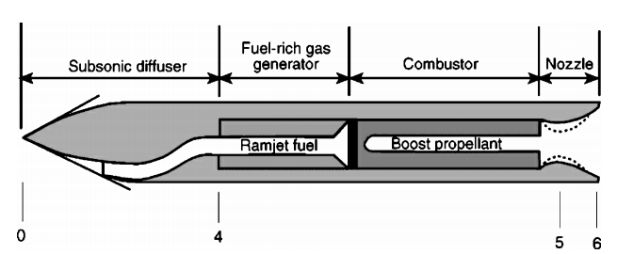
Course Project
Solid Fuel Ramjet Booster/Combustor Design
The course project for the spring 2023 class will use the principles of solid rockets, hybrid rockets to compare designs among: [A] pure solid propulsion, [B] hybrid, and a [C] solid boost/ramjet combustor design for a supersonic mission to achieve the greatest range. The instructor provides additional instructional material and students research supplementary technical papers on the ramjet component of this project that are not contained in the textbook. The instructor provides a Project Requirement Document that describes the mission requirements, guidelines and assumptions, and a list of technical symbols for the project

Slide 11
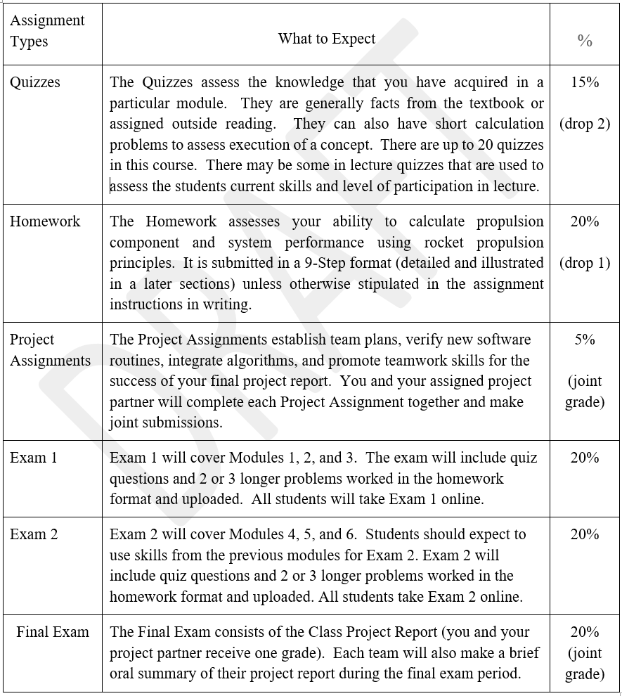
Assignment Descriptions

Slide 12
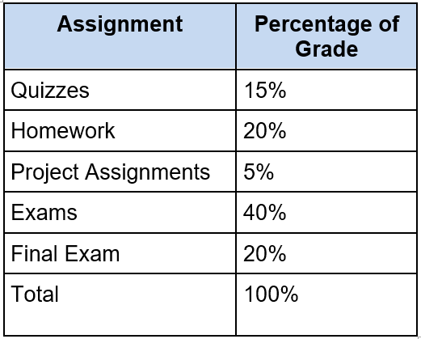
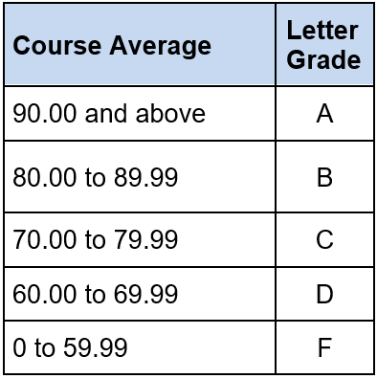
Basis of Grade

Slide 13
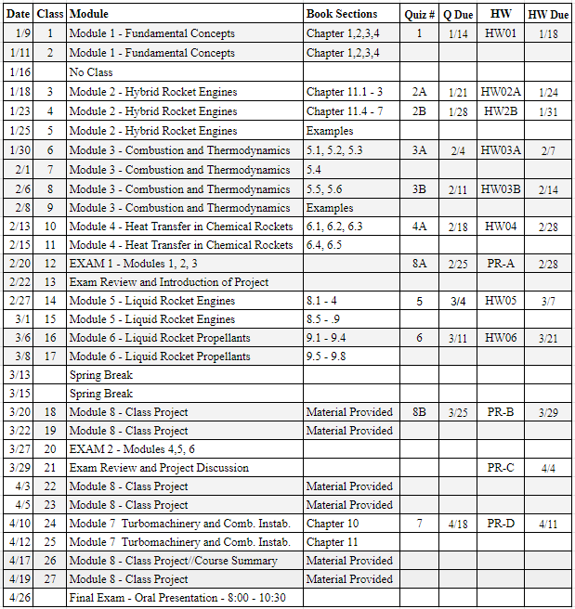
Course Schedule

Slide 14
Course Schedule

Slide 15
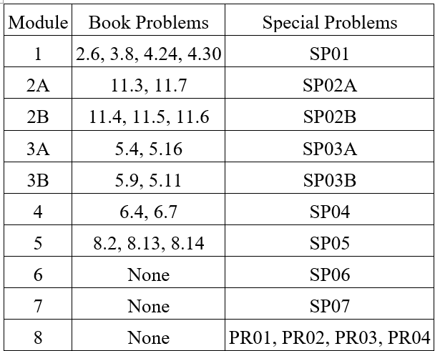
Homework Assignments

Slide 16
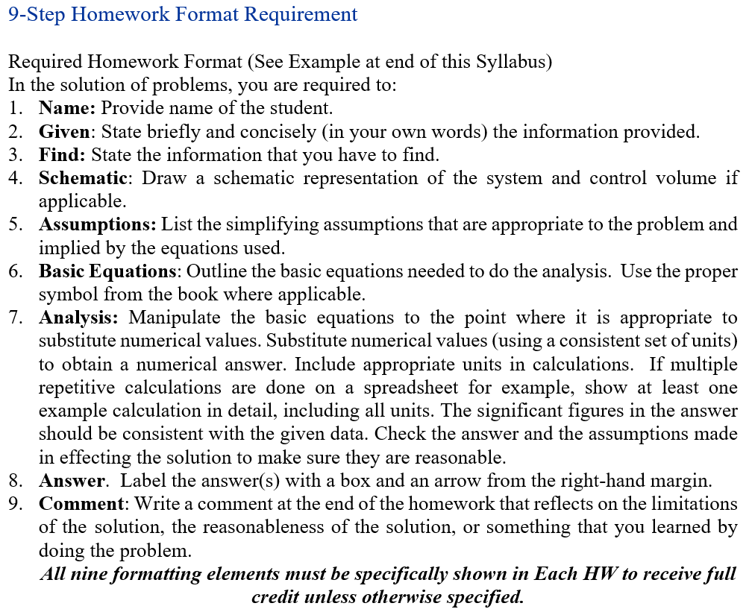
Required Homework Format

Slide 17
Online Items
Have Good Computer Connection/Camera/Microphone
Scan Homework Assignments into One Document
Email Instructor Through CANVAS and expect response within 24-48 hours.
Homework will be graded within one week of submission
Exams will be given online
Review the “Getting Started: Items on CANVAS Website.
Discussion

Slide 18
MAE 640 Rocket Propulsion II Lecture 01A – Fundamental Concepts
1.3 Classification of Rocket Propulsion Systems
2.1 Classification of Rocket Propulsion Systems
3.1 Vertical Trajectories, Example Problem (Mentioned)
Dr. Robert A. Frederick, Jr.
Professor, UAH MAE Department
Director, UAH Propulsion Research Center
Robert.Frederick@uah.edu
Phone: 256-503-4909

Slide 19
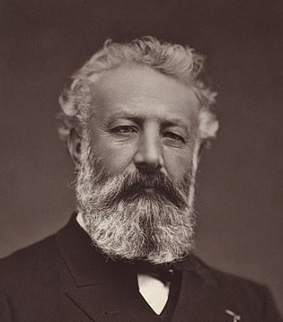
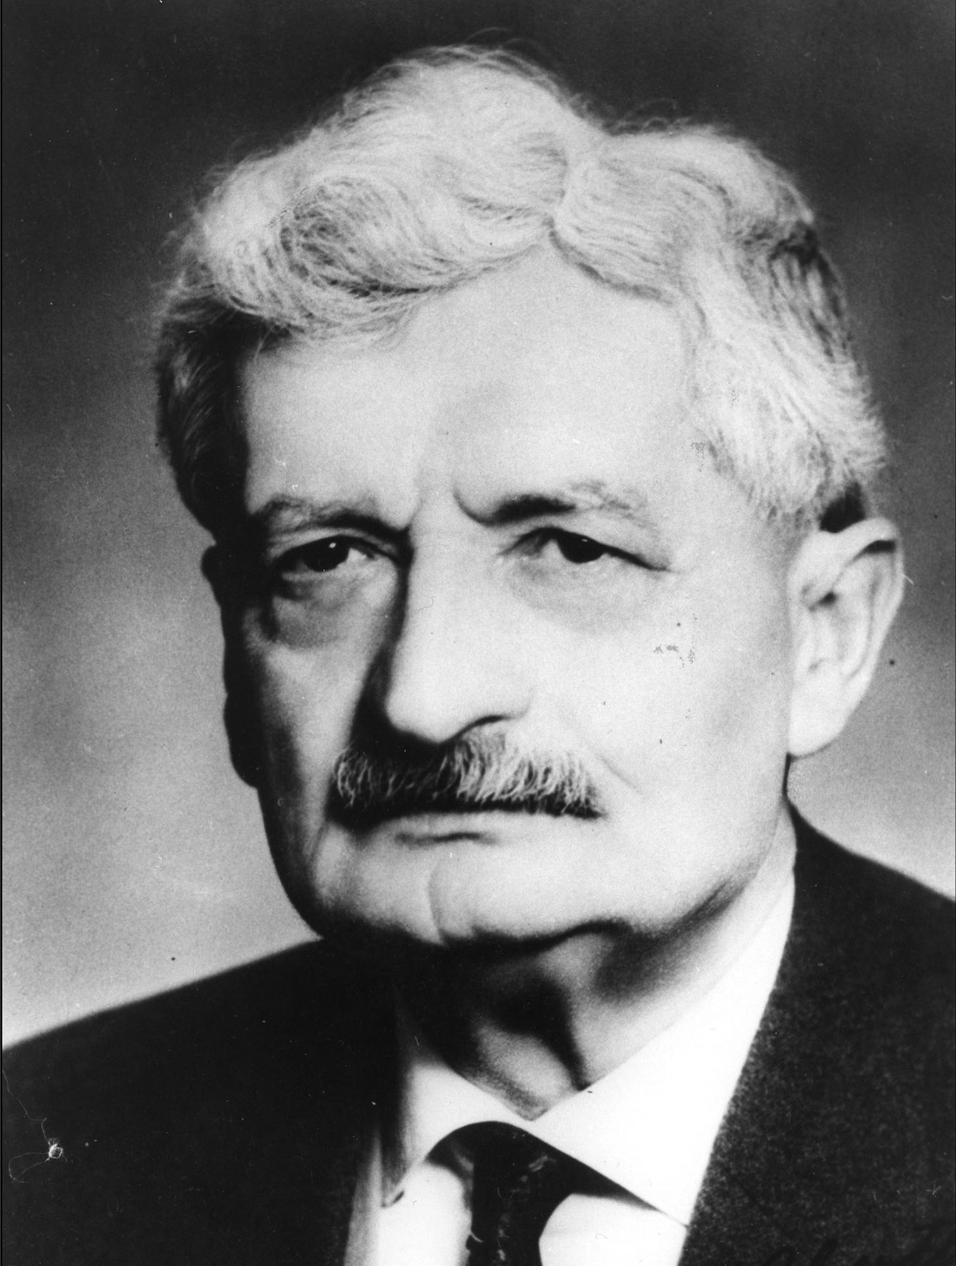

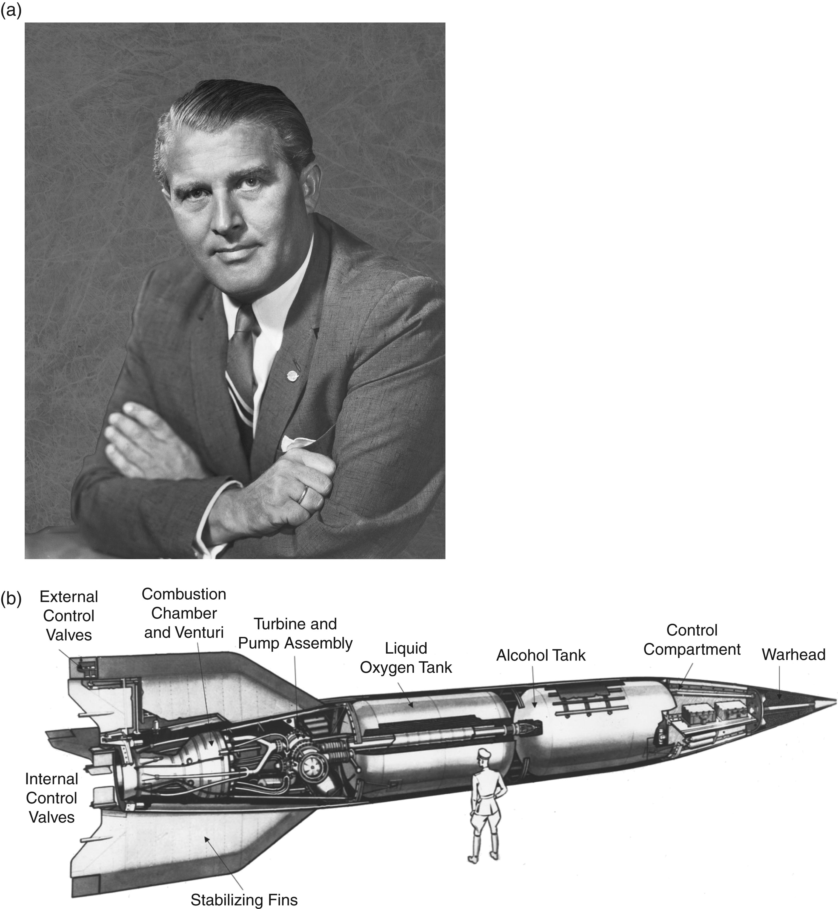
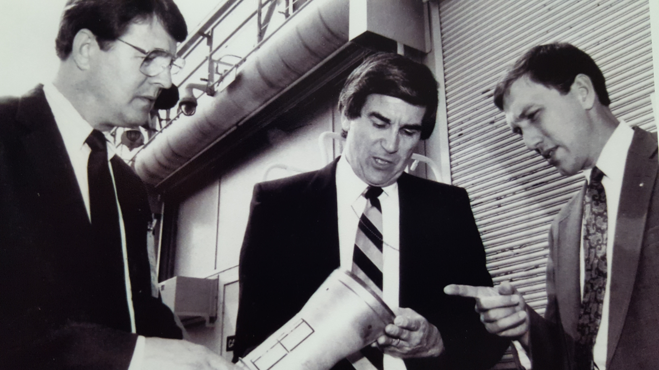
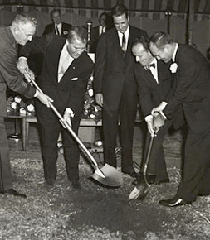
1.2 A Brief History of Rocketry Whose Inspiration brought UAH to Huntsville, Alabama?
Jules Verne
“From Earth to the Moon” 1863
Herman Oberth
?
Dr. Wernher Von Braun
UAH Propulsion Research Center
UAH Research Institute Groundbreaking
Major General Francis Morrow, Dr. Wernher von Braun, and Alabama Governor John Patterson
December 20, 1962
UAH
MAE 440/540
Rocket Propulsion I
130 Students - 2022
Dr. Hugh Coleman
Dr. Clark W. Hawk
Dr. Robert Frederick
August, 1991
Notes:
Jules Gabriel Verne 8 February 1828 – 24 March 1905^{[3]}) was a French novelist, poet, and playwright. His collaboration with the publisher Pierre-Jules Hetzel led to the creation of the Voyages extraordinaires,^{[3]} a series of bestselling adventure novels including Journey to the Center of the Earth (1864), Twenty Thousand Leagues Under the Seas (1870), and Around the World in Eighty Days (1872). His novels, always well documented, are generally set in the second half of the 19th century, taking into account the technological advances of the time.
Wernher Magnus Maximilian Freiherr von Braun (23 March 1912 – 16 June 1977) was a German-American aerospace engineer^{[3]} and space architect. He was a member of the Nazi Party and Allgemeine SS, as well as the leading figure in the development of rocket technology in Nazi Germany and a pioneer of rocket and space technology in the United States.^{[4]} As a young man, von Braun worked in Nazi Germany's rocket development program. He helped design and co-developed the V-2 rocket at Peenemünde during World War II. Following the war, he was secretly moved to the United States, along with about 1,600 other German scientists, engineers, and technicians, as part of Operation Paperclip.^{[5]} He worked for the United States Army on an intermediate-range ballistic missile program, and he developed the rockets that launched the United States' first space satellite Explorer 1 in 1958. He worked with Walt Disney on a series of films, which popularized the idea of human space travel in the US and beyond between 1955 and 1957.^{[6]}
In 1960, his group was assimilated into NASA, where he served as director of the newly formed Marshall Space Flight Center and as the chief architect of the Saturn V super heavy-lift launch vehicle that propelled the Apollo spacecraft to the Moon.^{[7][8]} In 1967, von Braun was inducted into the National Academy of Engineering, and in 1975, he received the National Medal of Science.
Von Braun is widely seen as either the "father of space travel",^{[9]} "father of rocket science"^{[10]} or "father of the American lunar program".^{[11]} He advocated a human mission to Mars.

Slide 20
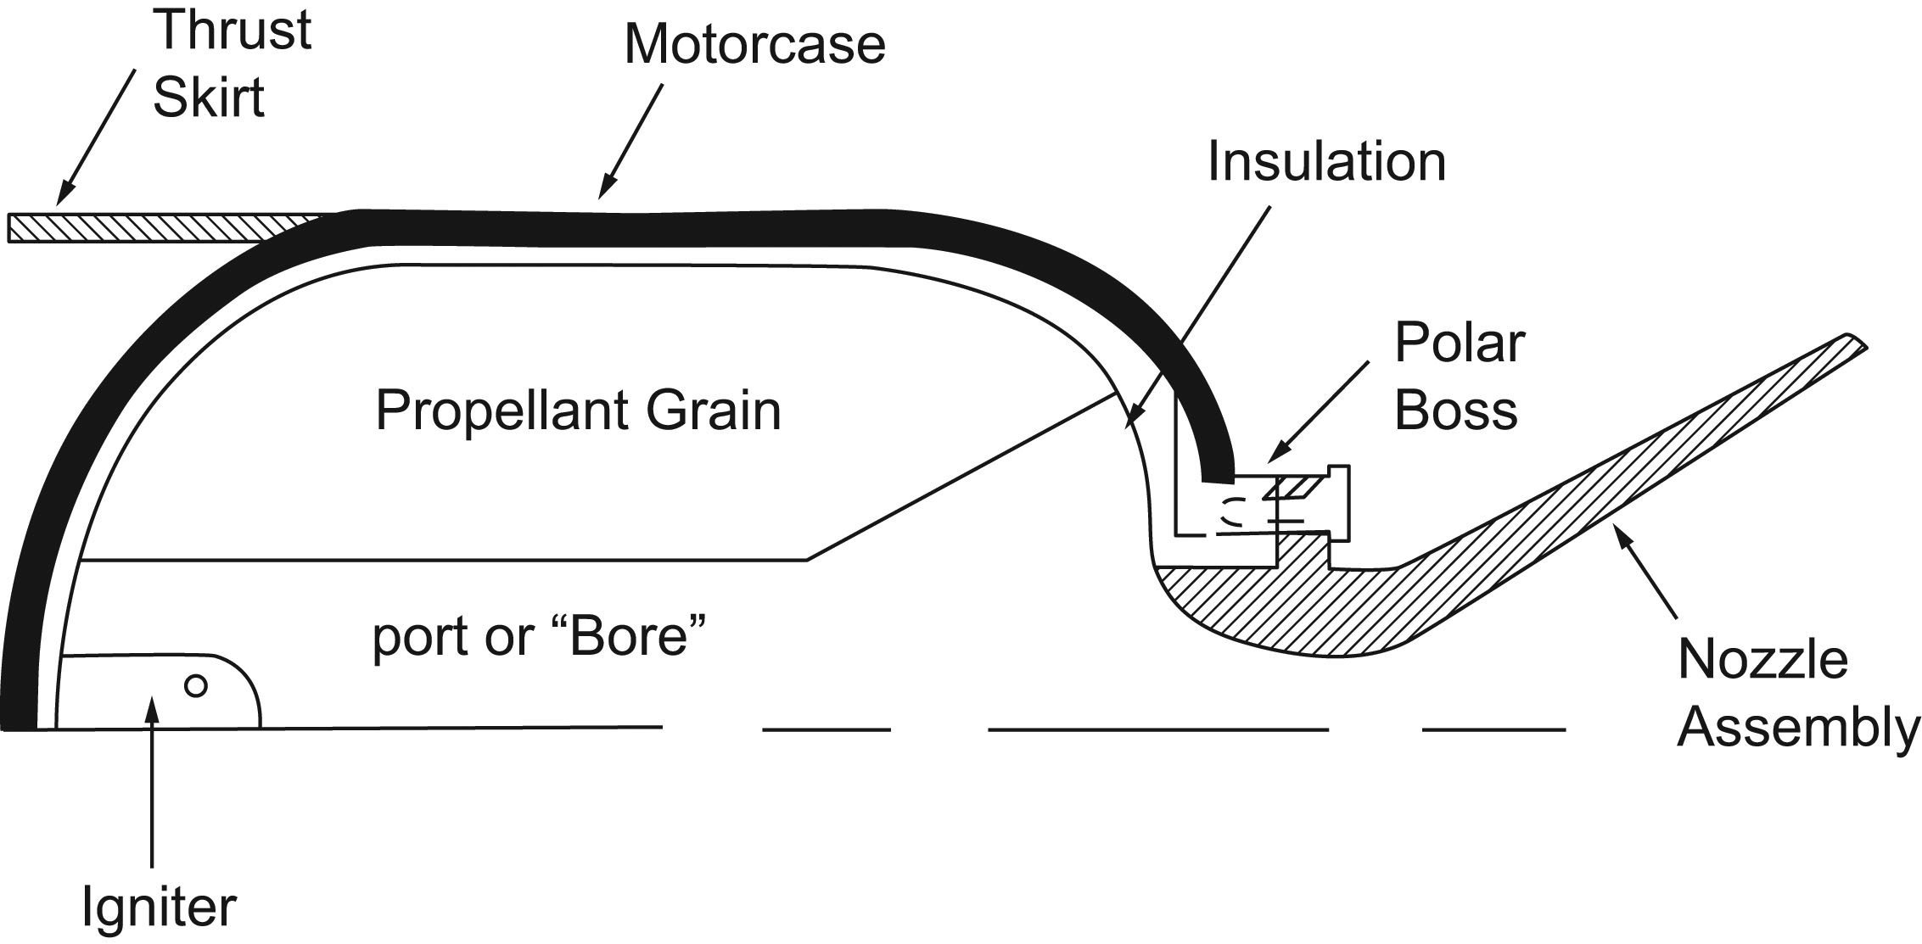
1.3.1 The Solid Rocket Motor (SRM)

Slide 21
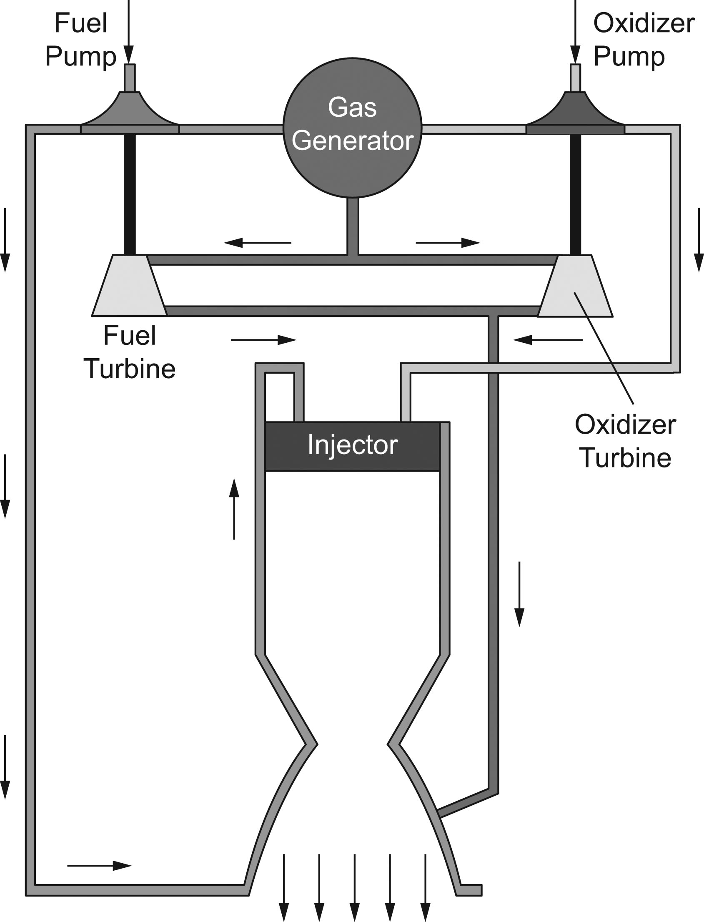
1.3.2 The Liquid Rocket Engine (LRE)

Slide 22
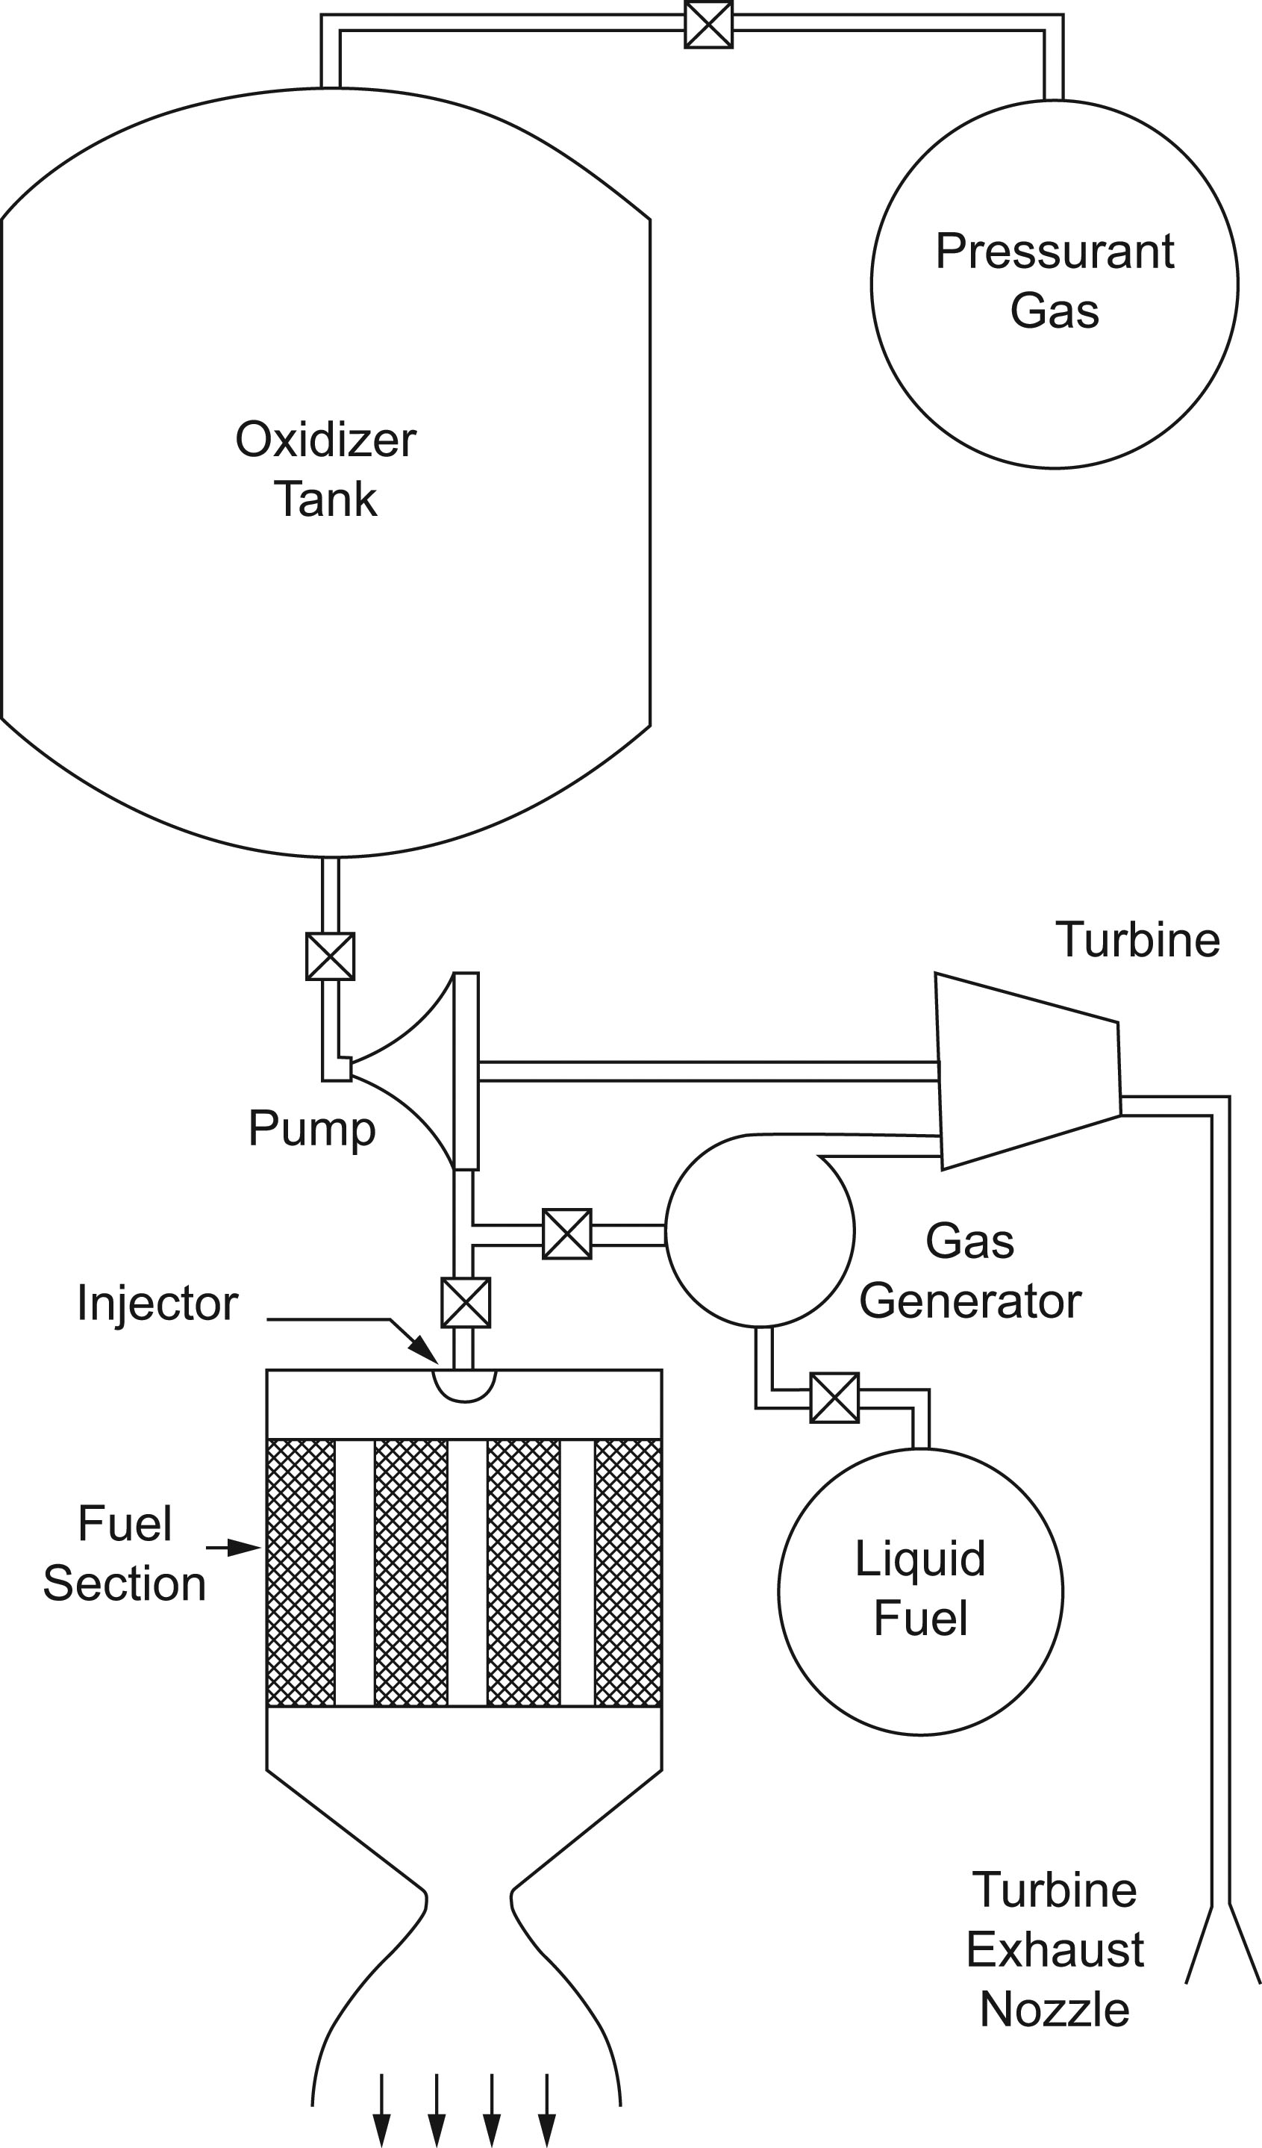
1.3.3 The Hybrid Rocket Engine

Slide 23
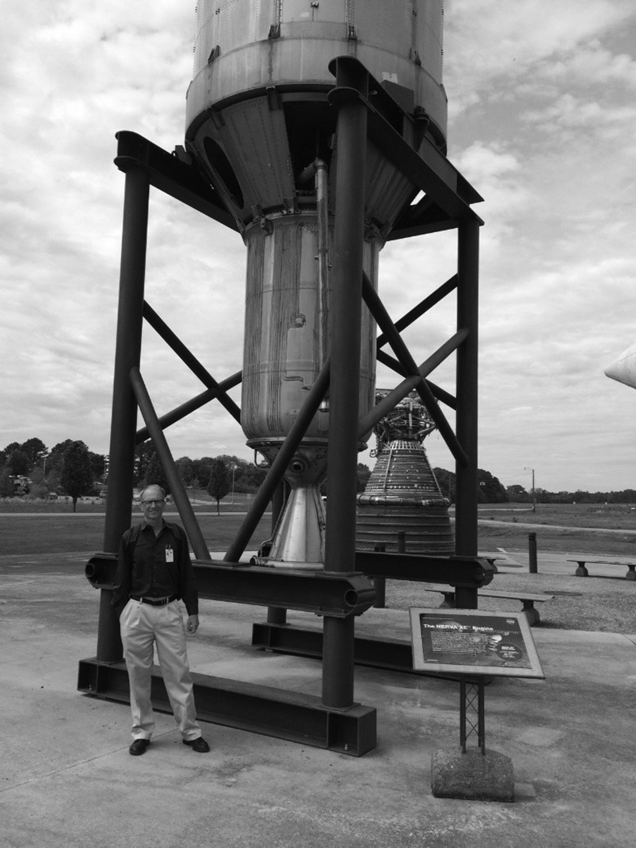
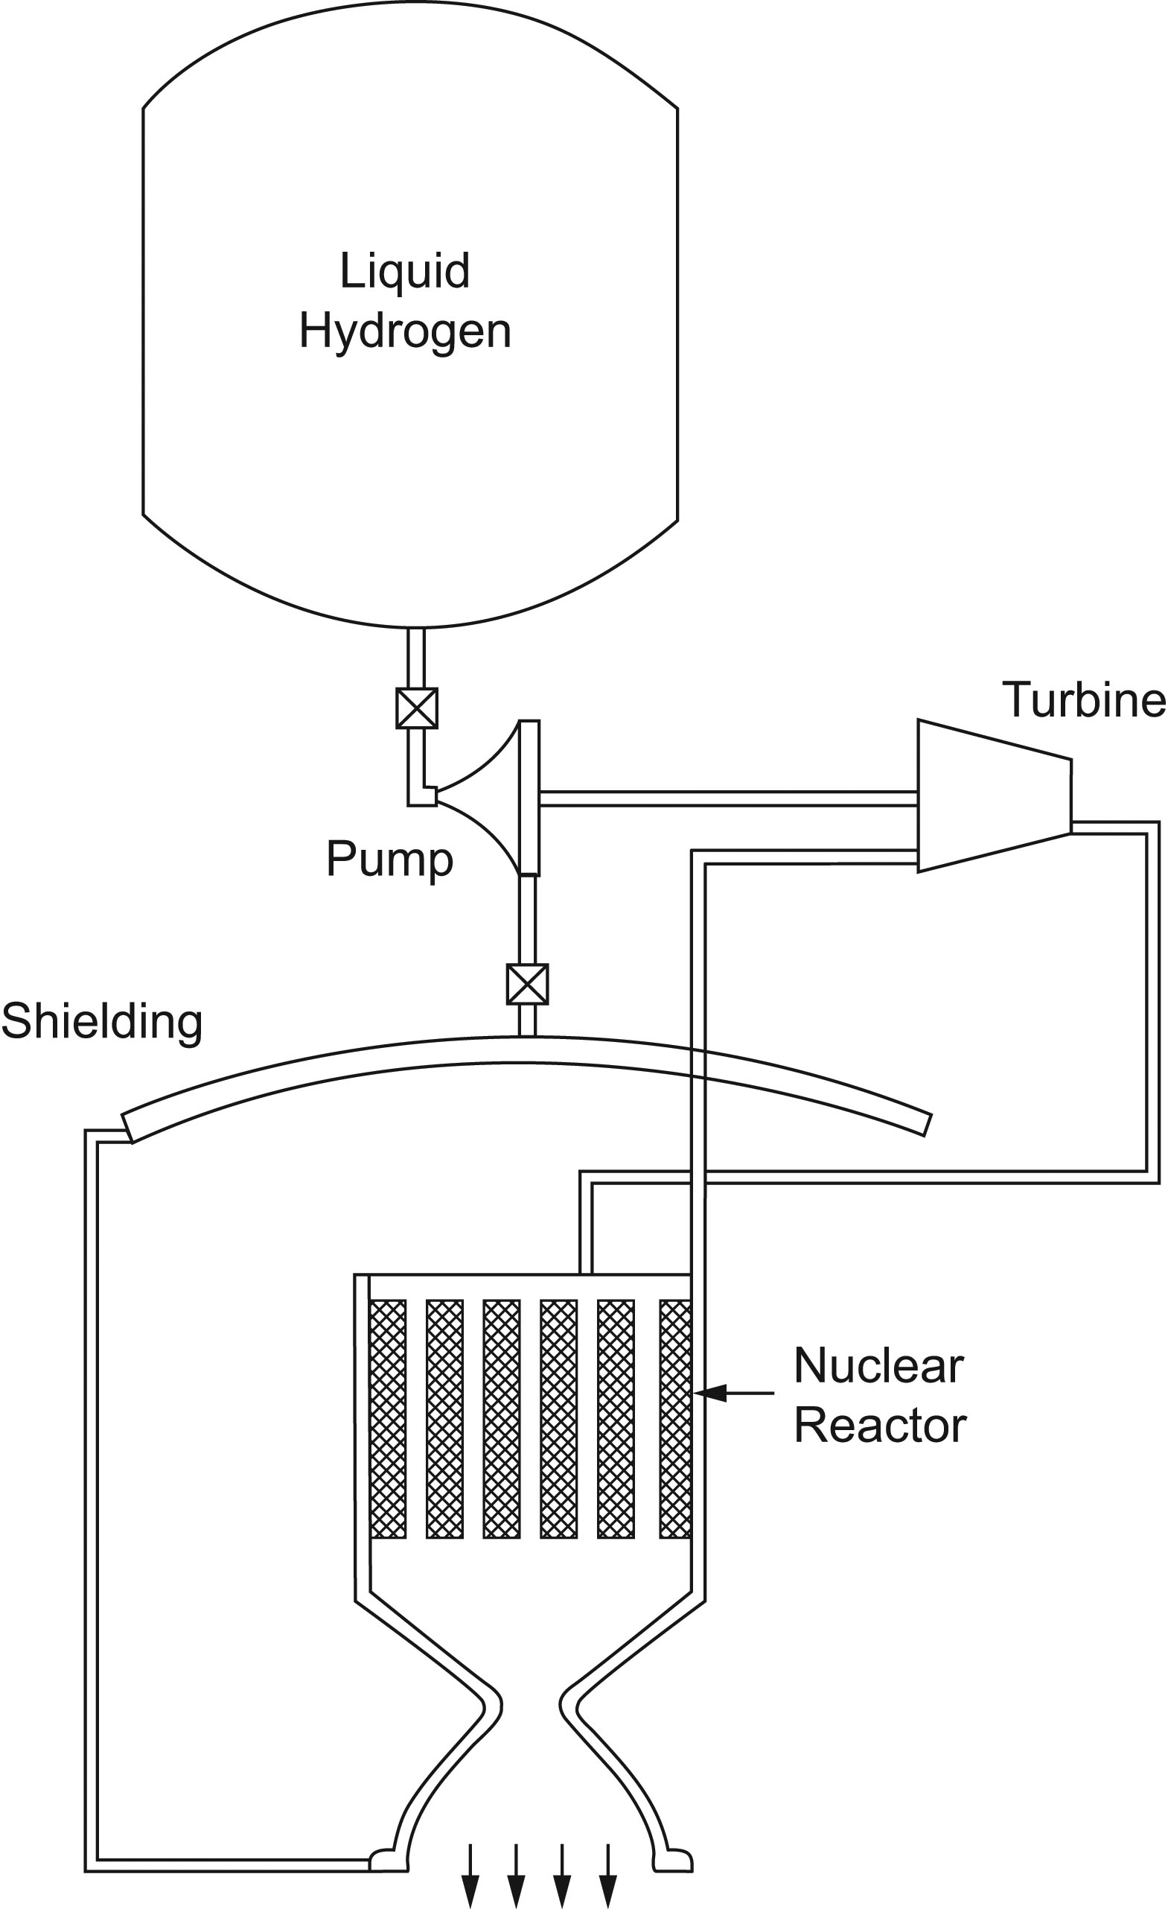
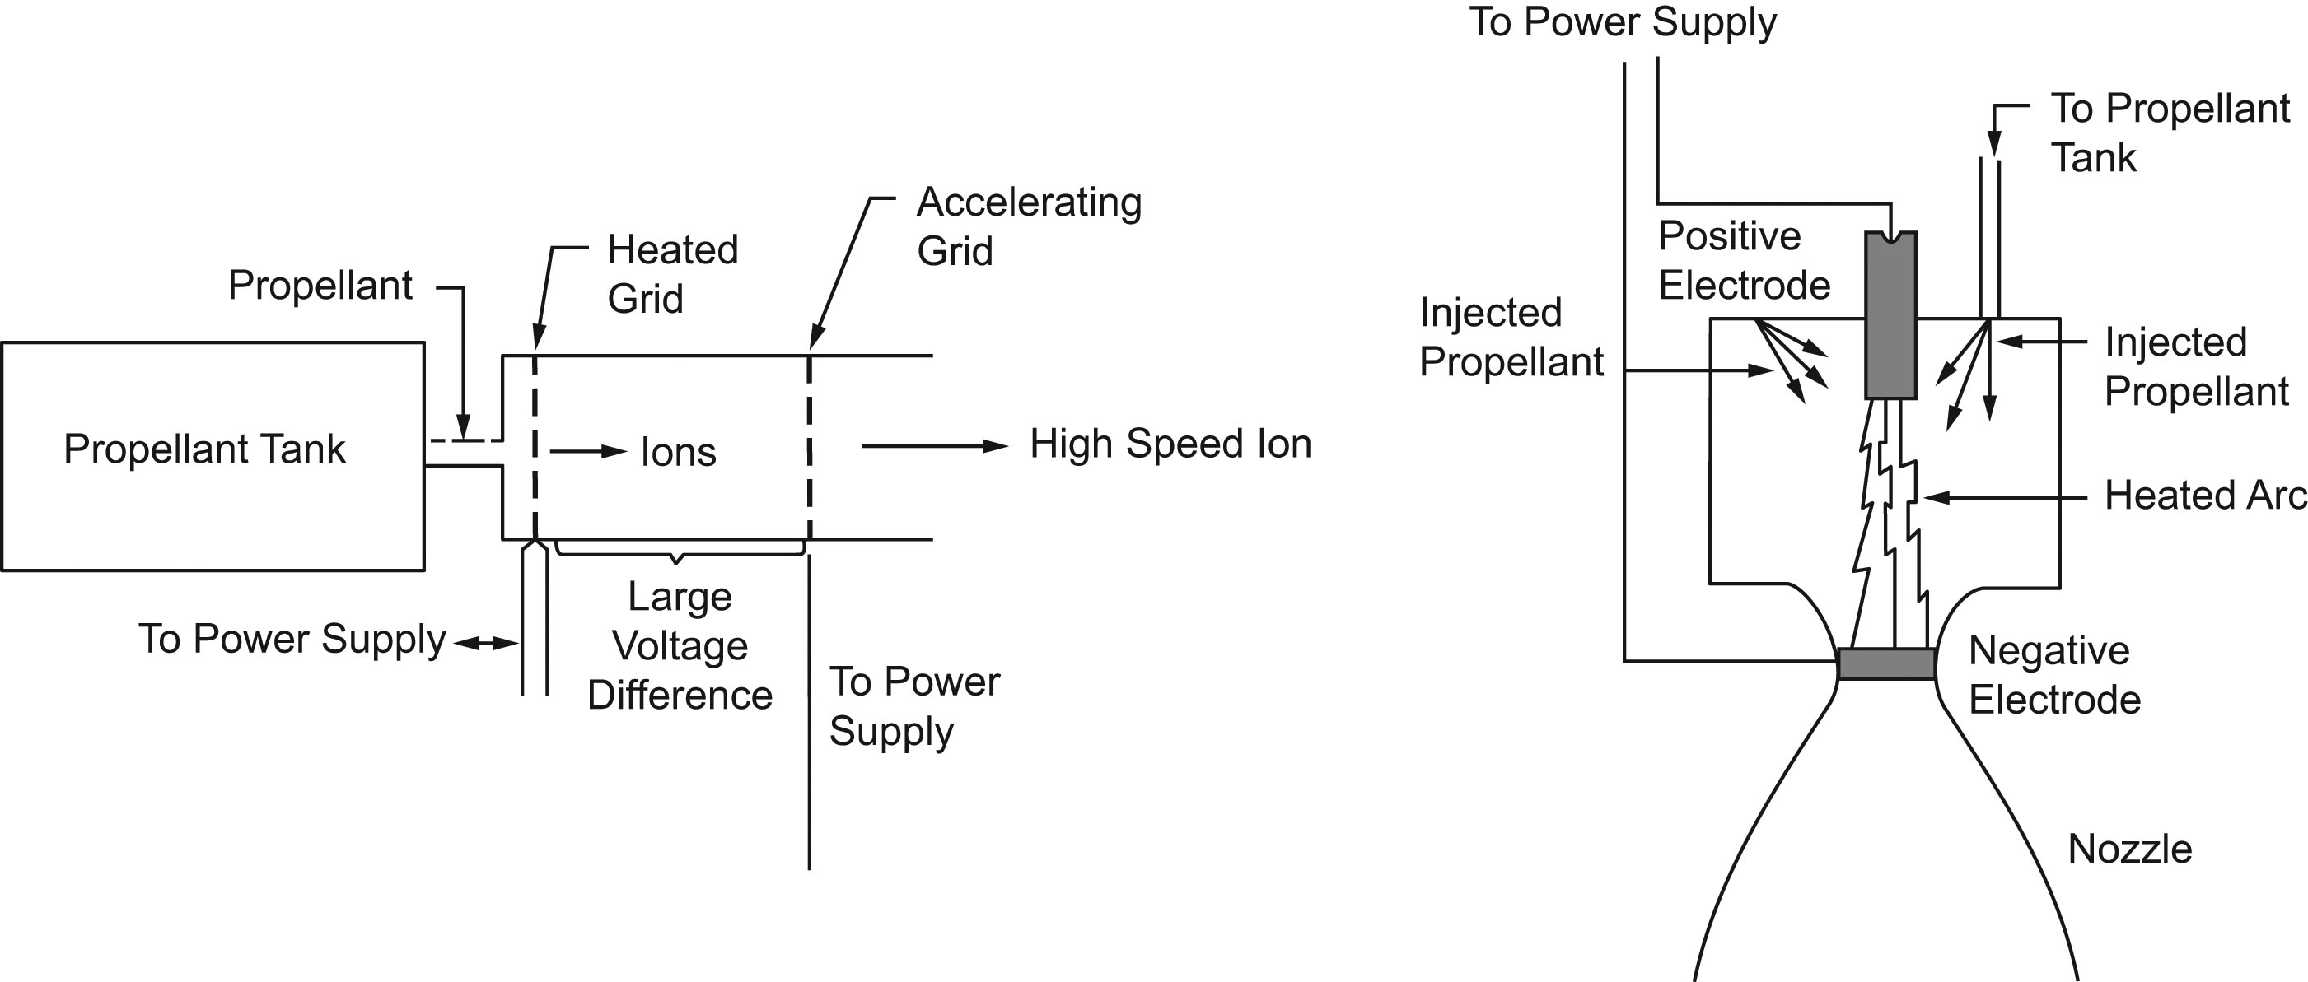
1.3.4 Nuclear Rocket Engines

Slide 24
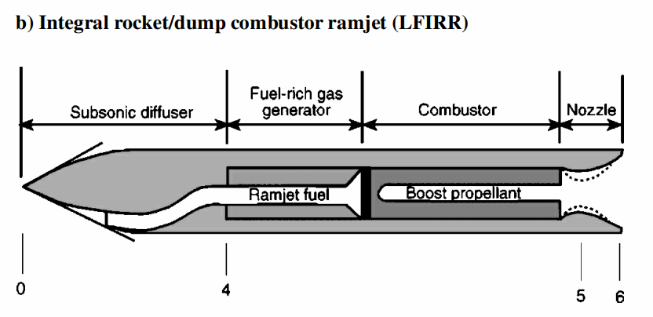
Integral Rocket/Dump Combustor Ramjet

Slide 25
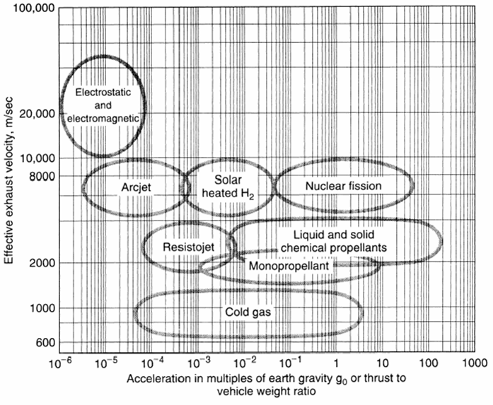
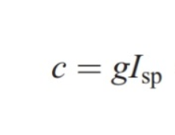
Comparison of Propulsion Systems

Slide 26
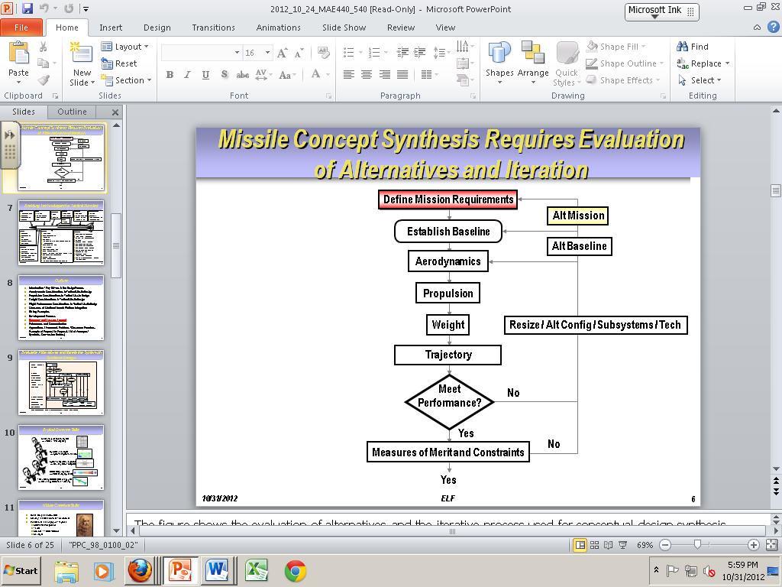
2.1 General Design Process for Rockets
Select a Propulsion System
Derive the Mission Requirements
Preliminary Design and Trade Study
Detailed Design and Fabrication
Demonstration and Qualification Testing
Iteration as Required
From Fleeman

Slide 27
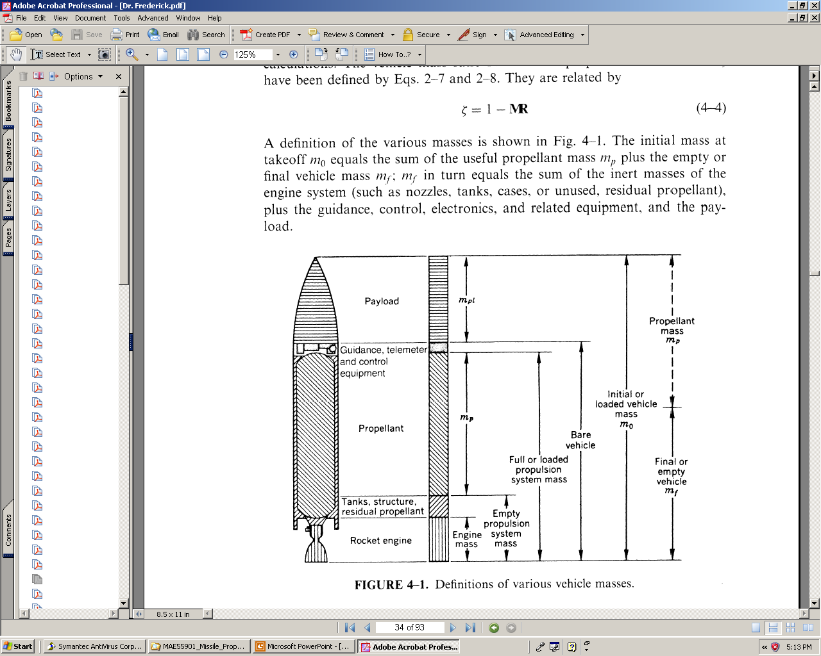
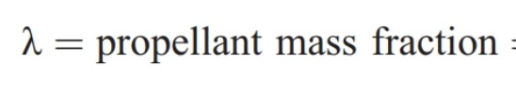
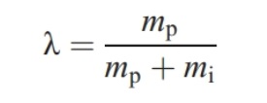
2.1 Vehicle Components
Inert Components
Propellant
Payload Components

Slide 28
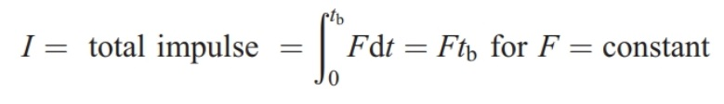
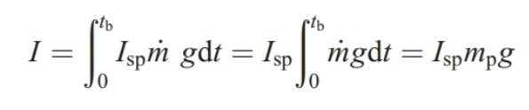
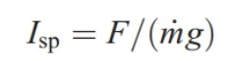
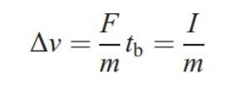
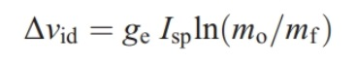
2.1 Driving Factors
Specific Impulse
Using a simplified constant mass assumption and F = m(dν/dt)
So delta V is proportional to the total impulse

Slide 29
Driving Factors
Specific Impulse
Using a simplified constant mass assumption and F = m(dν/dt)
So delta V is proportional to the total impulse

Slide 30
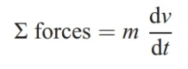
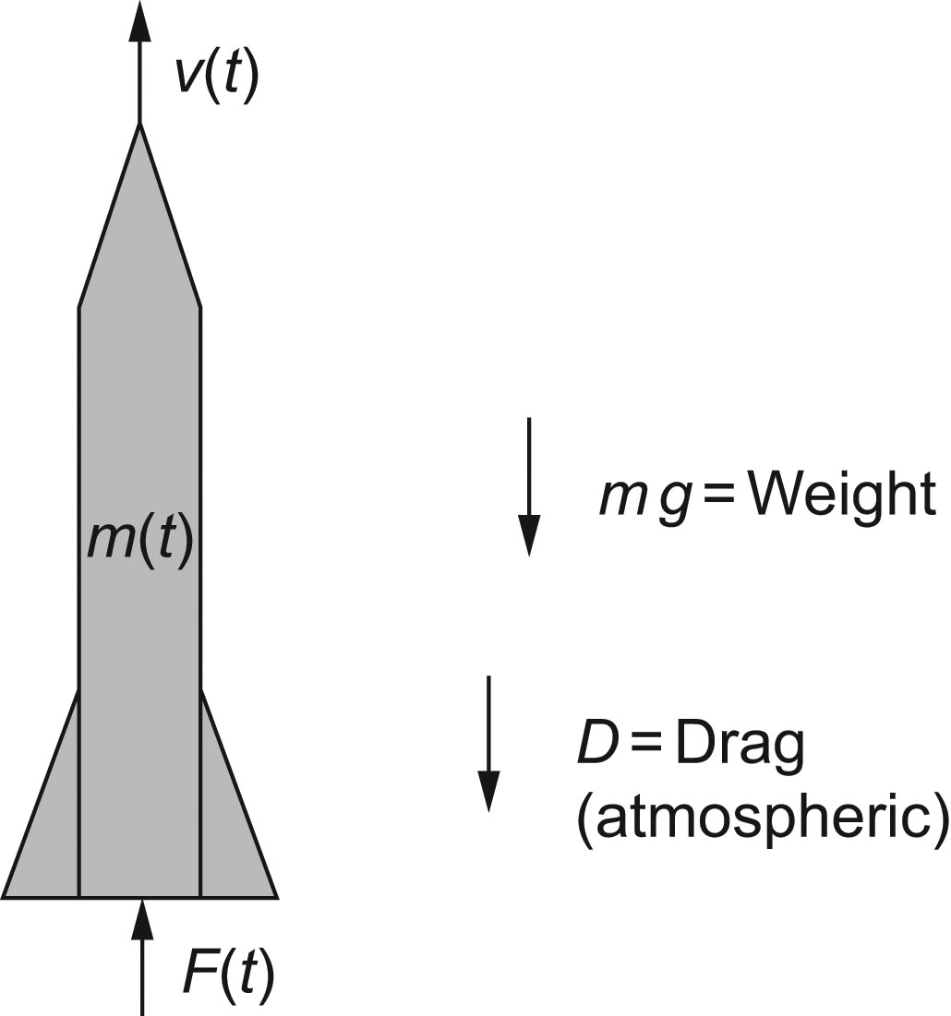
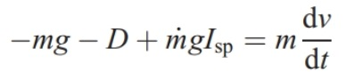
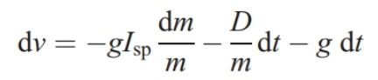
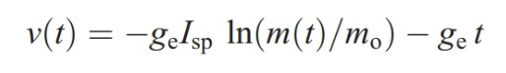
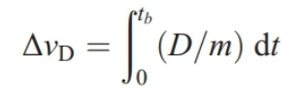
3.1 Vertical Trajectories

Slide 31
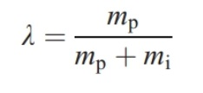
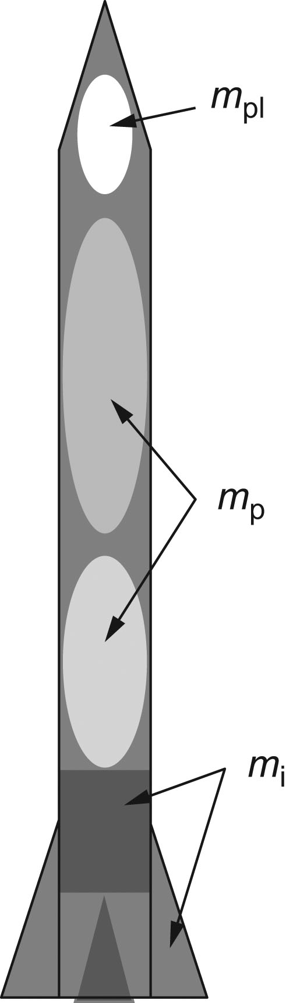
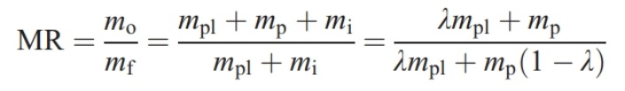
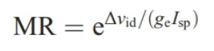
3.1 Vertical Trajectories

Slide 32
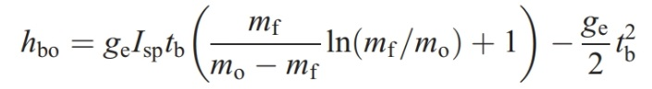
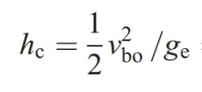
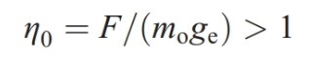
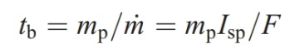
3.2 Burning Time and Accel. Effects

Slide 33
01 Homework Assignment
Textbook Problems
2.6, 3.8, 4.24, 4.30
Special Problems
SP01A Annotated Bibliography
Berg, P., Loeblich, W., and Frederick, R., “Using CEQUEL for Thermochemistry Calculations in a Graduate Rocket Propulsion Course at UAH,” 2023 AIAA SciTech, January 26, 2023.
SP01B Derive Basic Thrust Equation
SP01C Derive Basic Exit Velocity Equation
Remember to upload you entire assignment in one file. If you work by hand and do not have a scanner, there are phone aps that you can use to take picture and pdf the pictures into one file. We just need to be able to clearly see all the requested homework in one file.

Slide 34
Required Homework Format

Slide 35
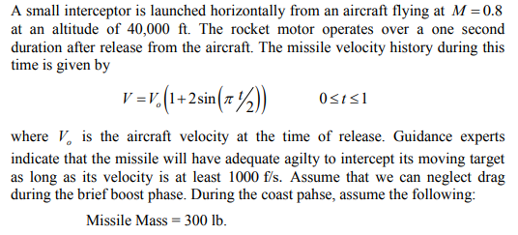
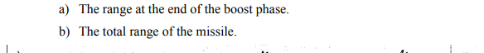
Homework 01 - Problem 2.6
Name : Instructor
Given:
Find:

Slide 36
Discussion of Thrust Equation

Slide 37
Discussion of Thrust Equation

Slide 38
Discussion of Thrust Equation

Slide 39
Discussion of Thrust Equation

Slide 40
Discussion of Thrust Equation

Slide 41
Discussion of Thrust Equation

Slide 42
Discussion of Thrust Equation

